Slide 1
Kratos Multiphysics Fluid Dynamics Application Tutorial
4th Kratos Multiphysics workshop
Rubén Zorrilla
Jordi Cotela
Riccardo Rossi
Javier Gárate

Slide 2
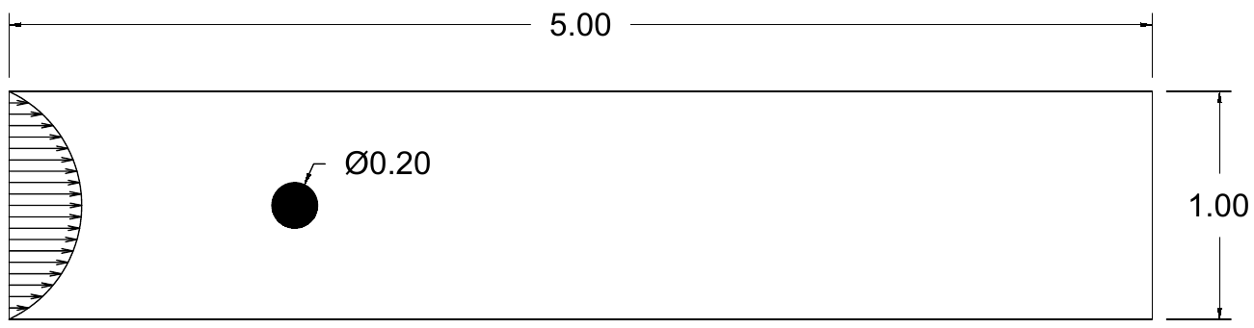
Kratos Multiphysics Fluid Dynamics Application Tutorial 0. 100 Re cylinder case
v = 0
v = v_{in}
p = 0
v_{cyl} = 0
v = 0
Inlet profile:
v_{x,in} = 6y(1-y)sin(πt/2) if t < 1
v_{x,in} = 6y(1-y) if t ≥ 1
Fluid properties:
ρ = 1.0 kg/m³
μ = 0.002 kg/m·s
Time settings:
Δt = 0.1 s
Tend = 45 s

Slide 3
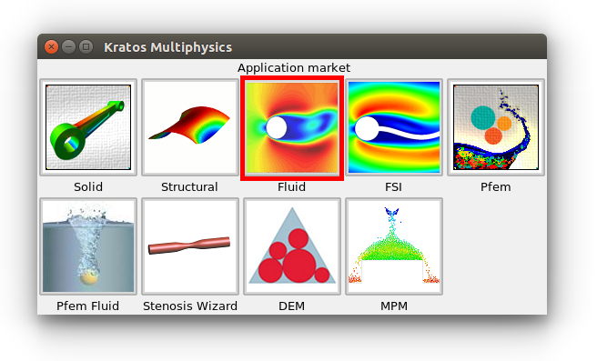
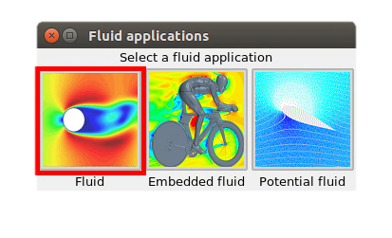
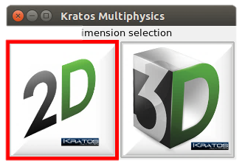
Kratos Multiphysics Fluid Dynamics Application Tutorial 1. Select Fluid Dynamics Application
Load the Kratos problem type: Data → Problem type → Kratos
1. Select Fluid Dynamics Application
2. Select body fitted CFD
3. Select problem size (2D)

Slide 4
Kratos Multiphysics Fluid Dynamics Application Tutorial 2. Draw geometry and set groups
Draw the channel + cylinder geometry:
Draw the channel boundaries
Draw the immersed cylinder
Remove all surfaces
Set a surface using the channel + cylinder boundaries
Set the required groups:
Inlet: left edge (1 line)
Outlet: right edge (1 line)
No_Slip_Walls: top and bottom edges (2 lines)
No_Slip_Cylinder: cylinder boundary (1 line)
Fluid: fluid domain surface (1 surface)

Slide 5
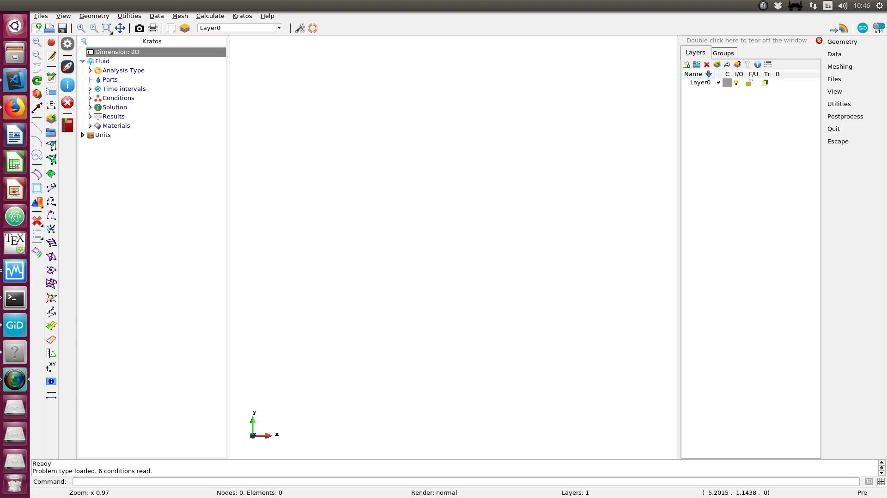
Kratos Multiphysics Fluid Dynamics Application Tutorial 2. Draw geometry and set groups

Slide 6
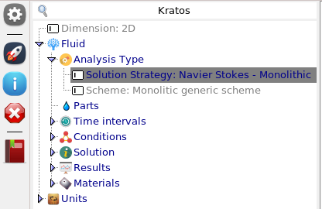
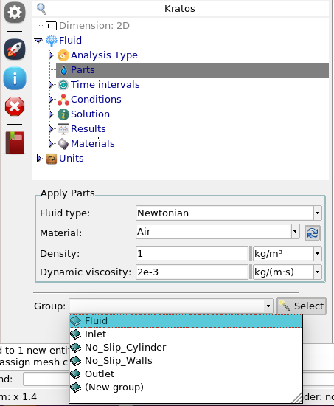
Kratos Multiphysics Fluid Dynamics Application Tutorial 3. Formulation and properties
Select formulation:
Analysis type → Solution strategy: Monolithic
Parts (fluid domain and properties):
Set properties (ρ, μ)
Apply to the Fluid group
NOTE: Only one part is allowed, meaning that all the surfaces (volumes) that conform the fluid domain must be stored in a unique group

Slide 7
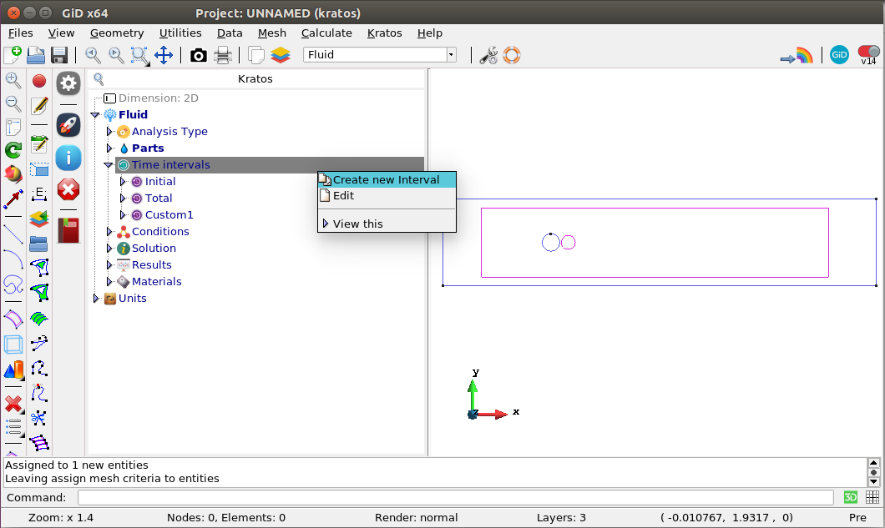
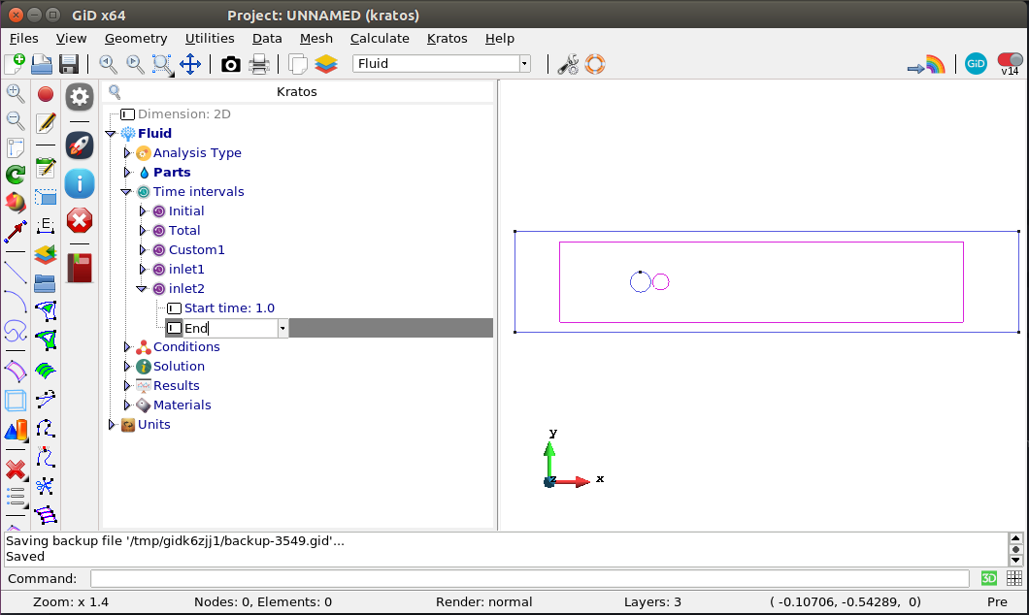
Kratos Multiphysics Fluid Dynamics Application Tutorial 4. Time intervals
Create time intervals:
Set the time intervals to apply the problem BCs.
To create a new time interval:
Right click over “Time intervals”
Click “Create new interval”
Fill the time interval data
In this case:
inlet1: Start time: 0.0 // End time: 1.0
inlet2: Start time: 1.0 // End time: “End” (string)

Slide 8
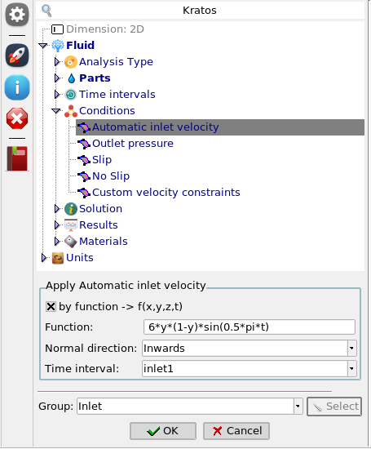
Kratos Multiphysics Fluid Dynamics Application Tutorial 5. Boundary conditions
Inlet (t < 1):
Inside the Conditions tab:
Double click “Automatic inlet velocity”
Select “by function” option
Introduce the first velocity function:
6*y*(1-y)*sin(0.5*pi*t)
Set the time interval from 0.0 to 1.0 (inlet1)
Apply to the Inlet group
NOTE: Any Python compiled function depending on x, y, z and t can be introduced.

Slide 9
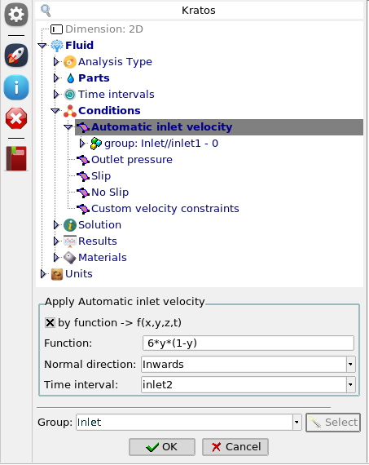
Kratos Multiphysics Fluid Dynamics Application Tutorial 5. Boundary conditions
Inlet (t ≥ 1):
Inside the Conditions tab:
Double click “Automatic inlet velocity”
Select “by function” option
Introduce the second velocity function
6*y*(1-y)
Set the time interval from 1.0 to “End” (inlet2)
Apply to the Inlet group
NOTE: Any Python compiled function depending on x, y, z and t can be introduced.

Slide 10
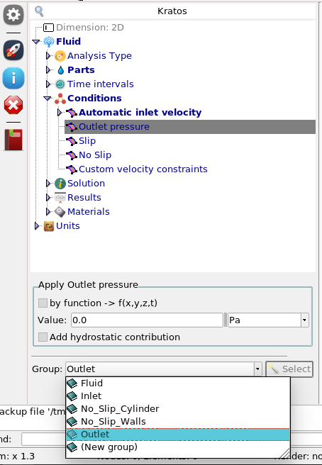
Kratos Multiphysics Fluid Dynamics Application Tutorial 5. Boundary conditions
Outlet:
Inside the Conditions tab:
Double click “Outlet”
Set value to 0.0
Apply to the Outlet group

Slide 11
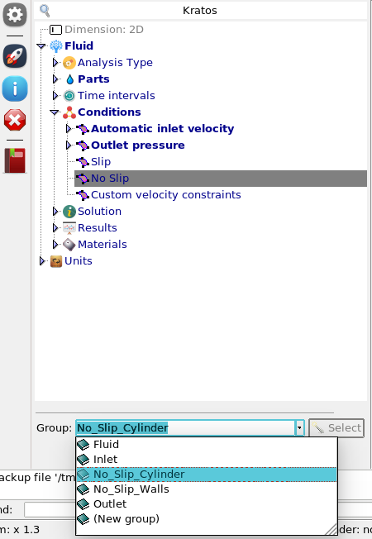
Kratos Multiphysics Fluid Dynamics Application Tutorial 5. Boundary conditions
No slip:
Inside the Conditions tab:
a) Cylinder
Double click “No slip”
Apply to the No_Slip_Cylinder group
b) Walls
Double click “No slip”
Apply to the No_Slip_Walls group

Slide 12
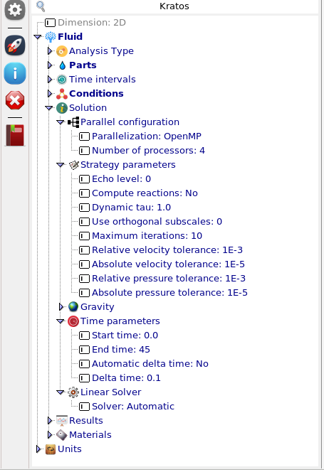
Kratos Multiphysics Fluid Dynamics Application Tutorial 6. Solver and time settings
Inside the Solution tab:
Solver settings:
a) Parallel configuration: OpenMP / MPI
b) Strategy parameters: Defaults are OK
c) Linear solver: Let Kratos select the suitable one
Time settings:
Set “Start time” to 0.0
Set “End time” to 45.0
Set “Delta time” to 0.1
(“Automatic delta time” can be used instead)

Slide 13
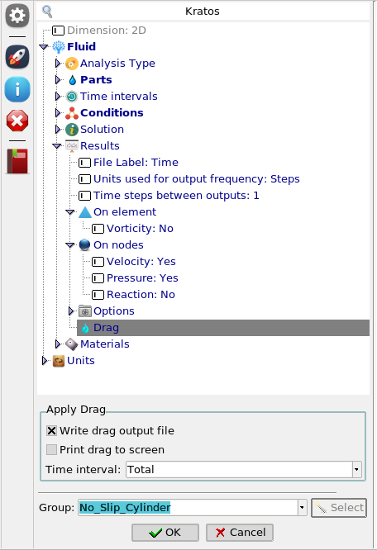
Kratos Multiphysics Fluid Dynamics Application Tutorial 7. Post-process settings
Inside the Results tab:
Output type:
a) Output unit: Steps / time
b) Frequency: 1.0 (each step)
Output variables: velocity and pressure
Drag computation:
a) Time interval: Total
b) Drag group: No_Slip_Cylinder

Slide 14
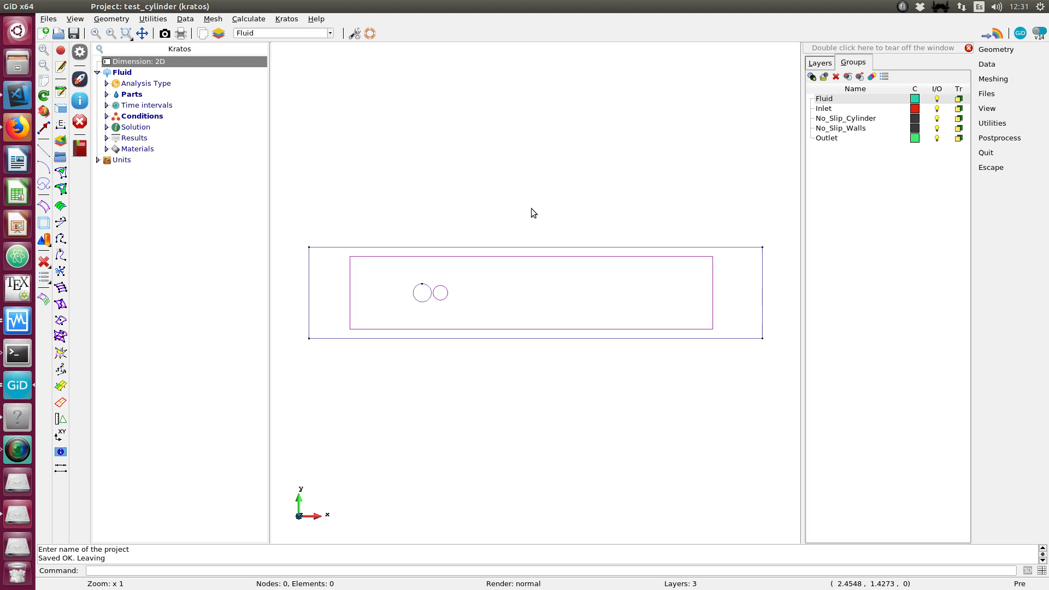
Kratos Multiphysics Fluid Dynamics Application Tutorial 8. Mesh & solve

Slide 15
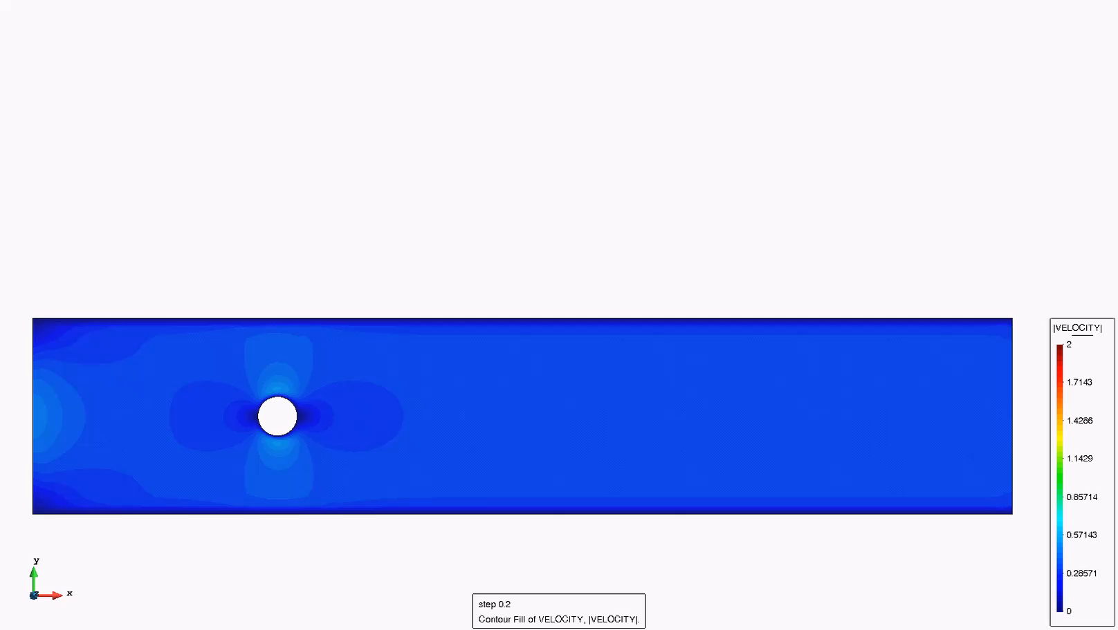
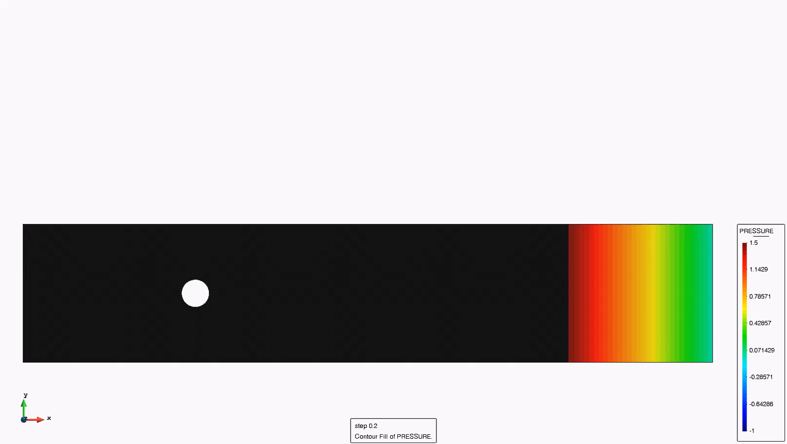
Kratos Multiphysics Fluid Dynamics Application Tutorial 9. Results

Slide 16
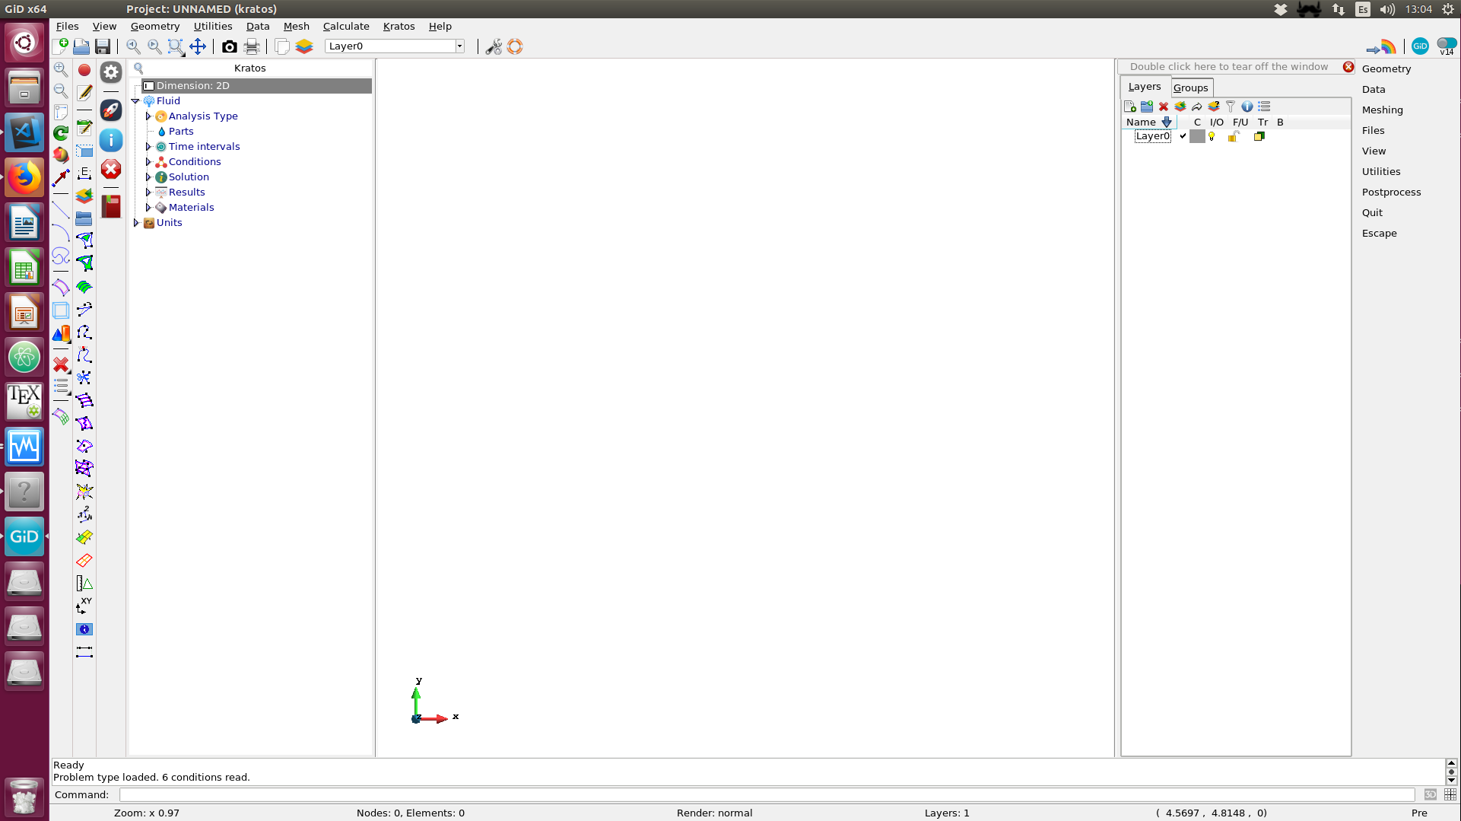
Kratos Multiphysics Fluid Dynamics Application Tutorial
The presented example can be automatically reproduced by clicking in this icon.

Slide 17
THANK YOU

